Slide 1
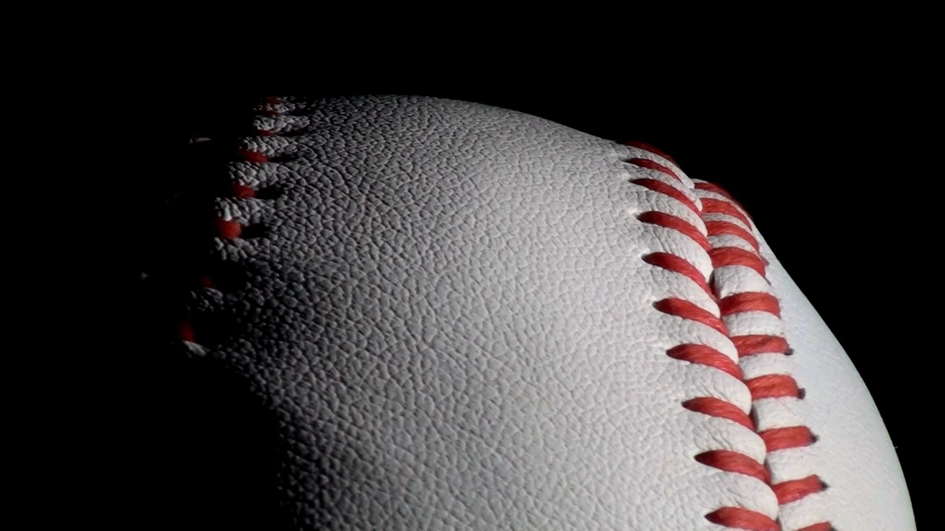
Dodgers Game Summary
DSC630
Shaquiel Pashtunyar

Slide 2
How to get more people in our stadium
We will be looking at a couple of charts to find out what is the best method of getting our attendance up for baseball games.

Slide 3
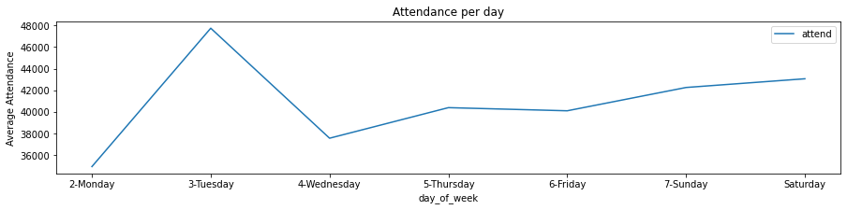
Day of the week and time comparison
From here we can see more people attend games on Tuesday or Sunday,

Slide 4
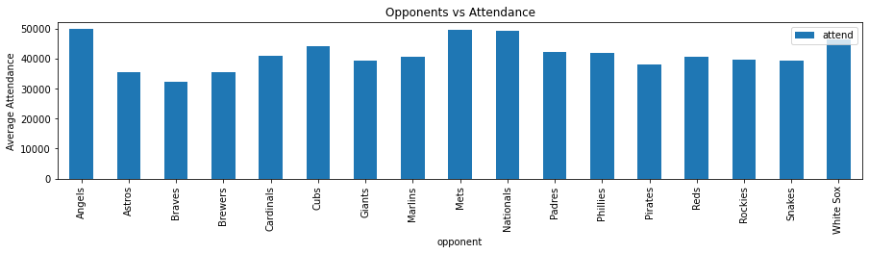
Opponent effect on attendance
Some opponents that the dodgers have rivalries with, like LA, bring in larger attendance rates

Slide 5
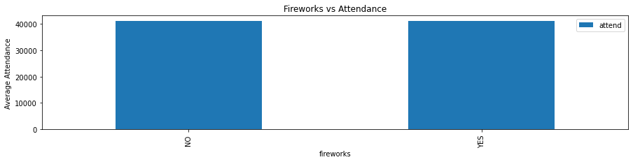
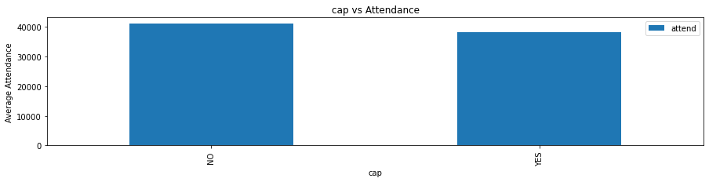
Costly Merchandise at a game
We see that having fireworks is a neutral correlation and having a baseball cap that is given out is a negative correlation in attendance
fireworks
NO 41032.179104
YES 41077.857143
cap
NO 41112.240506
YES 38189.500000

Slide 6
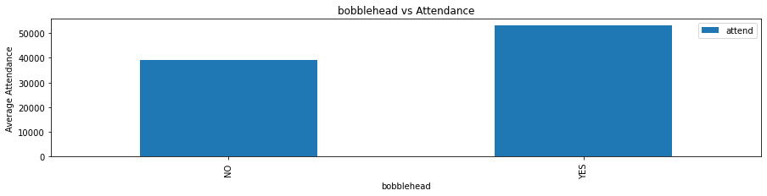
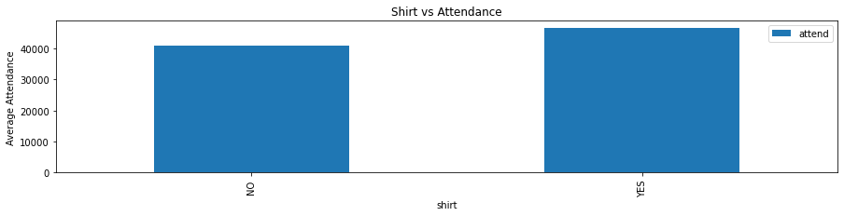
Costly Merchandise at a game
We also see giving out bobbleheads or T shirts are positive correlations on attendance
bobblehead
NO 39137.928571
YES 53144.636364
shirt
NO 40824.551282
YES 46643.666667

Slide 7
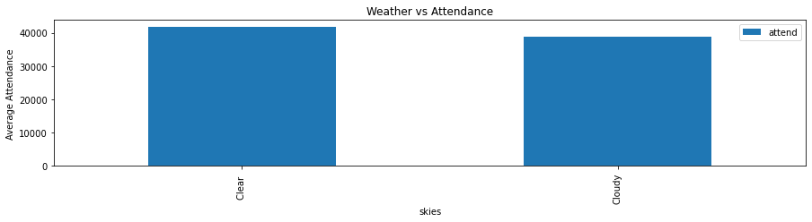
Weather effect
Weather also has a slightly positive effect on the amount of people at a game
skies
Clear 41729.209677
Cloudy 38791.315789

Slide 8
Thoughts and conclusions
Certain merchandise like hats or fireworks don’t influence attendance. Maybe because most people own a hat already or can’t take fireworks home.
The rivalries or certain match ups bring in more attendance than lesser-known teams.
Tuesday is surprisingly best day for a game to happen, and the weather needs to be clear. This is followed up by Sundays.
Clear skies influence attendance, likely because no one wants to go out when they think its going to rain

Slide 9
Suggestions
In order to get more people at baseball games, it is in our belief that we need to have a schedule that has plenty of our rival teams playing. We should focus on having the major games on Sunday and Tuesday for max audiences. We also should plan to give out free t shirts or bobbleheads to individuals to lure them in. If weather is abiding and we have clear skies, these scenarios will increase attendance at games. Certain behaviors like giving out baseball hats or a firework show are no recommended as they don’t seem to have a positive effect on the attendance at games.

